Slide 1
Real-time Speed Estimation: Final Presentation
Bolat Tleubayev and Zhanel Zhexenova

Slide 2
Why?

Slide 3
Why?
safety

Slide 4
Why?
safety
control

Slide 5
Why?
safety
control
monitor

Slide 6
How?

Slide 7
How?
input

Slide 8
How?
Detection
Tracking
Mapping
input

Slide 9
How?
Detection
Tracking
Mapping
output
input

Slide 10
Detection: Method 1
Accumulative Difference Image

Slide 11
Detection: Method 1
Accumulative Difference Image
Frame
n

Slide 12
Detection: Method 1
Accumulative Difference Image
Frame
n
-
Frame
n+1

Slide 13
Detection: Method 1
Accumulative Difference Image
Frame
n
-
Frame
n+1
Morphology

Slide 14
Detection: Method 1
Accumulative Difference Image
Frame
n
-
Frame
n+1
Morphology
output

Slide 15
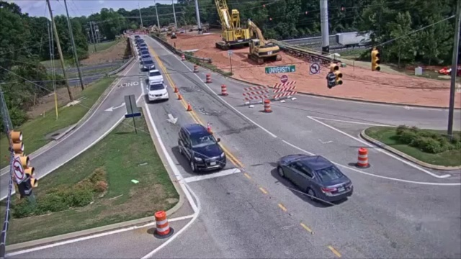
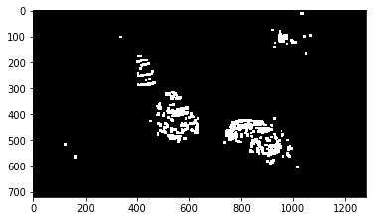
Detection: Method 1
Accumulative Difference Image
-
Morphology

Slide 16
Detection: Method 1
Accumulative Difference Image

Slide 17
Detection: Method 2
Difference from clear background

Slide 18
Detection: Method 2
Difference from clear background
Clear
Frame

Slide 19
Detection: Method 2
Difference from clear background
Clear
Frame
-
Frame
n

Slide 20
Detection: Method 2
Difference from clear background
Clear
Frame
-
Frame
n
Morphology

Slide 21
Detection: Method 2
Difference from clear background
Clear
Frame
-
Frame
n
Morphology
output

Slide 22
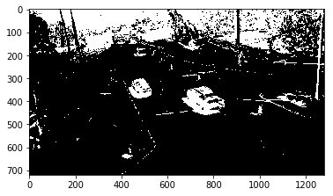
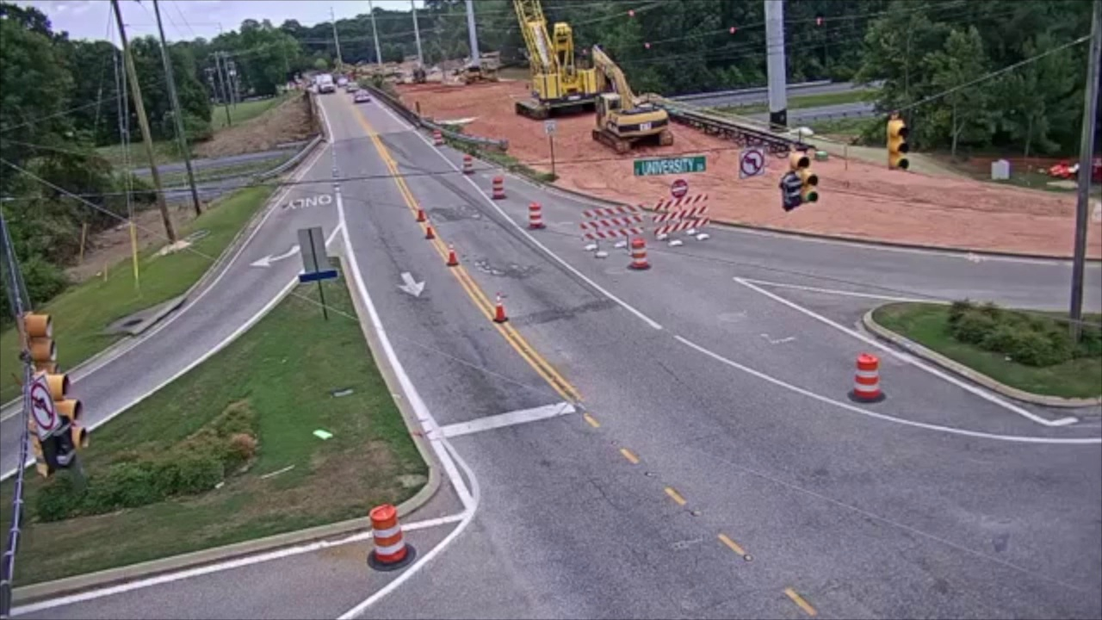
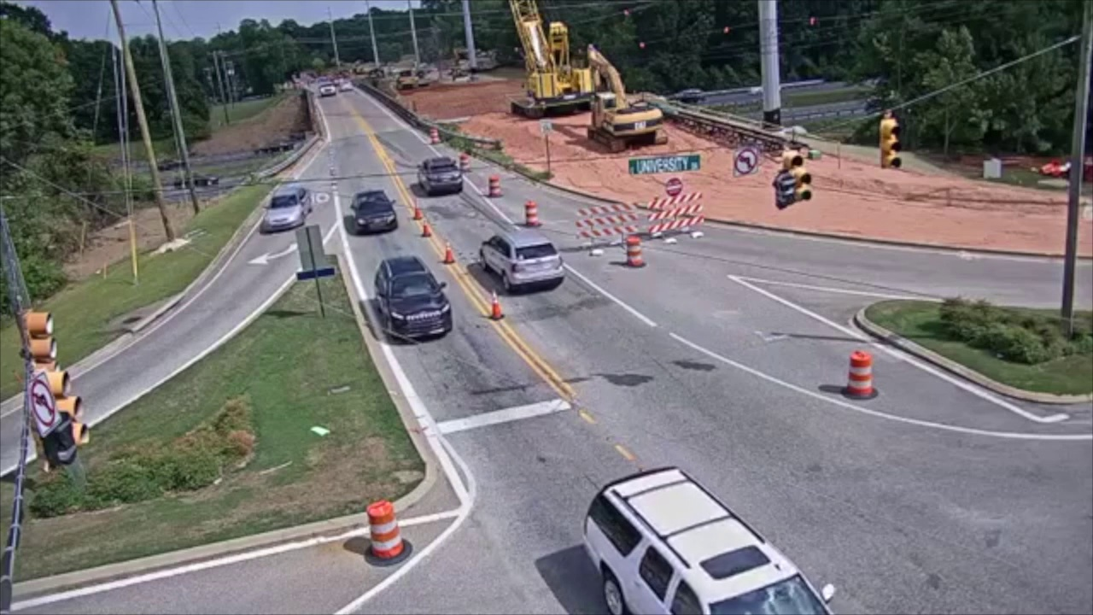
Detection: Method 2
Difference from clear background
-
Morphology

Slide 23
Detection: Method 2
Difference from clear background

Slide 24
Detection: Method 3
Thresholding

Slide 25
Detection: Method 3
Thresholding
Set asphalt pixels to 1,
everything else to 0

Slide 26
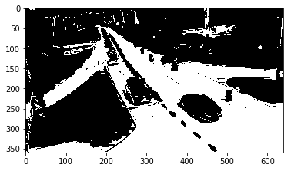
Detection: Method 3
Thresholding

Slide 27
Detection: Method 3
Thresholding
Set Region of Interest
on the road

Slide 28

Detection: Method 3
Thresholding

Slide 29
Detection: Method 3
Thresholding
Subtract ROI from
Thresholded image

Slide 30
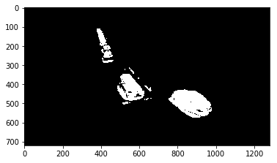
Detection: Method 3
Thresholding

Slide 31
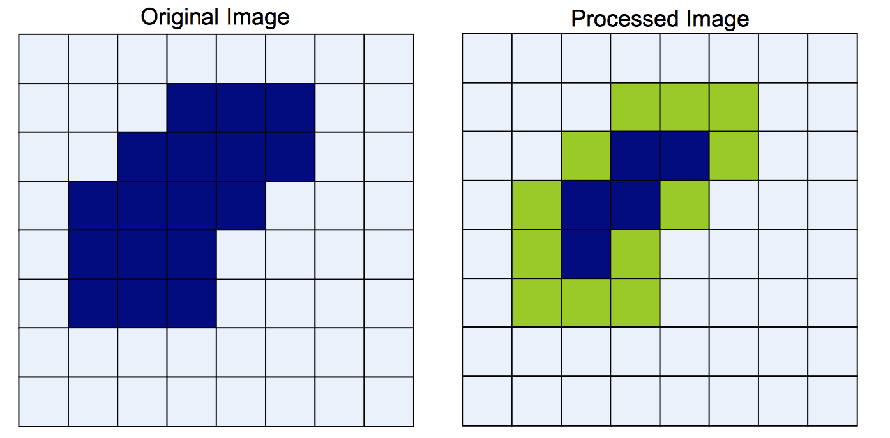
Morphology
Erosion
Taken from lecture notes of ROBT310 Image Processing, Spring 2019

Slide 32
Morphology
Erosion
Features:
Variable kernel
Binary image as input and output

Slide 33
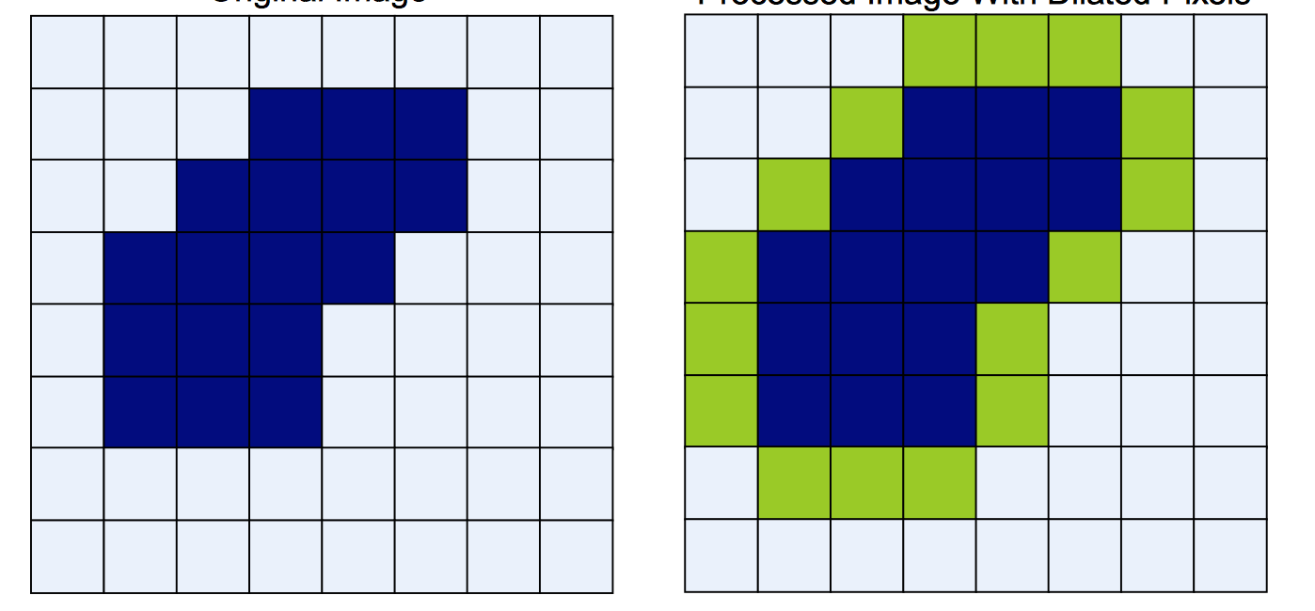
Morphology
Dilation
Taken from lecture notes of ROBT310 Image Processing, Spring 2019

Slide 34
Morphology
Dilation
Features:
Variable kernel
Binary image as input and output

Slide 35
Computational considerations
Nested loops
Slow computation

Slide 36
Computational considerations
Nested loops
Faster computation
Numba

Slide 37
Features:
Python compiler
Boosts computation
Easy to use
Taken from https://numba.pydata.org

Slide 38
Tracking
Contour labelling
Tracking

Slide 39
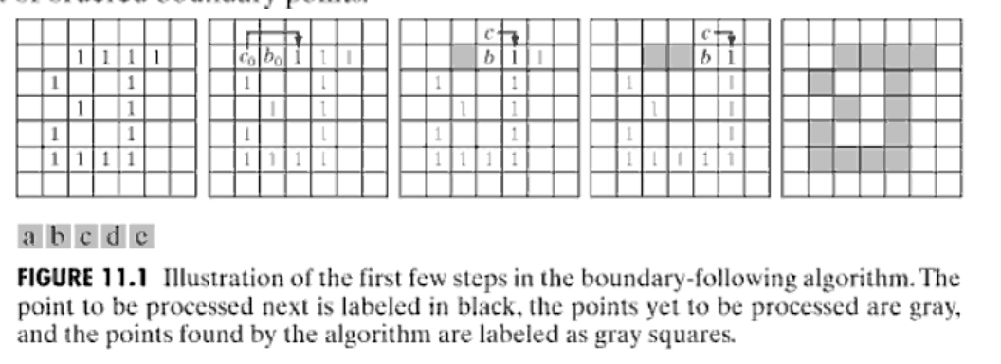
Contour labelling
Moore Pixel Following
Taken from lecture notes of ROBT310 Image Processing, Spring 2019

Slide 40
Tracking
Previous
Frame
Current
Frame
object

Slide 41
Tracking: Case 1
Previous
Current

Slide 42
Tracking: Case 2
Previous
Current

Slide 43
Tracking: Case 3
Previous
Current

Slide 44
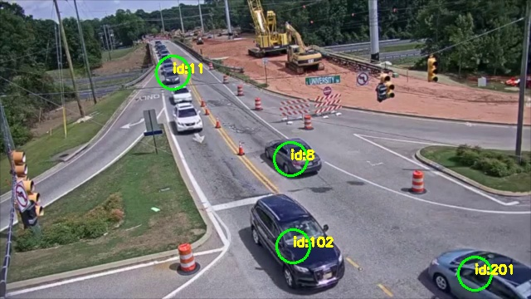
Tracking: Output

Slide 45
Speed estimation
Homography
Mapping
Speed Estimation

Slide 46
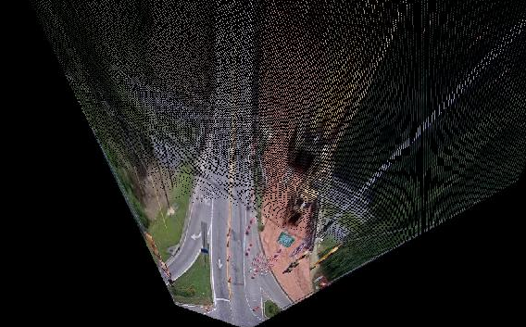
Homography

Slide 47
Mapping
City of Auburn, Alabama, USA
East University Dr and Moores Mill

Slide 48
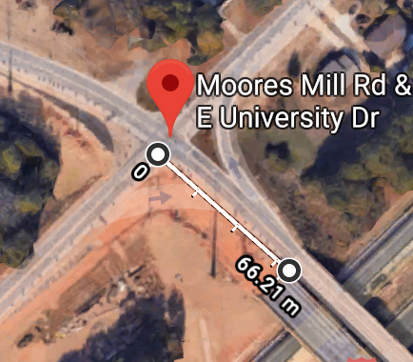
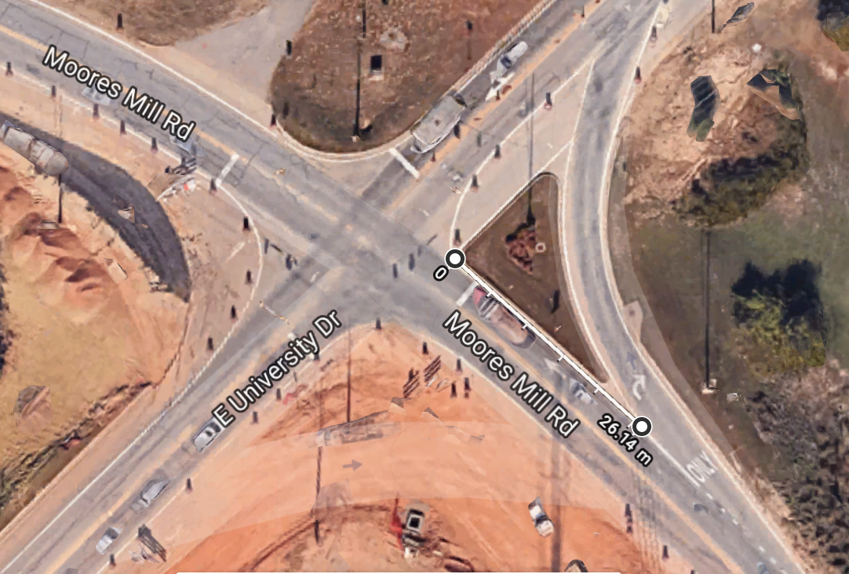
Mapping

Slide 49
Speed estimation
object on
frame n
Distance
object on
frame n+1

Slide 50
Speed estimation
d* FPS * C = Speed [m/s]
d = distance (w.r.t homography)
FPS = frames per second
C = mapping coefficient

Slide 51
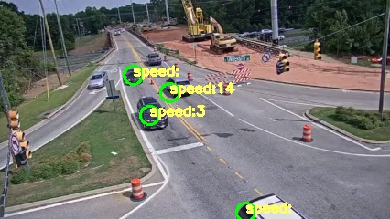
Final output

Slide 52
Challenges
Computational
Efficiency

Slide 53
Challenges
Car segmentation

Slide 54
Thank you!

